Slide 1

AI-Powered Social Media Content Suggestion Tool
Group Members:
Husnain Naseem (2k21-BSCS-103)
Mursleen Bukhari (2k21-BSCS-113)
Miraj Arshad (2k21-BSCS-126)
Supervisor: Dr. Naeem Aslam
Department of Computer Science
NFC Institute of Engineering & Technology, Multan

Slide 2

Outline
Introduction
Background
Problem Statement
Proposed Solution
Novelty
Tools & Technologies
Requirements
Diagrams
Interface
Implementation
Testing
Content Genius

Slide 3
Introduction
Social media success relies on timely and engaging content, but staying updated with trends and writing creative posts can be challenging. Our tool solves this by fetching real-time trends and generating AI-powered post suggestions using Gemini and Groq Api. It’s fast, intelligent, and designed for content creators and marketers.

Slide 4
Background / Existing Systems
Buffer, Hootsuite : schedule posts, but no AI suggestions
ChatGPT : generates content but not trend-aware
No system that fetches trends + generates platform-ready posts

Slide 5
Problem Statement
In today’s digital world, content creators struggle to keep up with social media trends due to time-consuming research and creative demands. The lack of an integrated tool for trend discovery and AI based content suggestions leads to inefficiencies and slower content creation.

Slide 6
Proposed Solution
Fetches live trends from:
Twitter, YouTube, Reddit, Pakistani news
Uses Gemini and Groq AI to generate creative posts
Easy-to-use, mobile-friendly interface

Slide 7
Novelty / Uniqueness
Real-time multi-platform trend aggregation
AI-generated post
User-specific dashboard & profile history

Slide 8
Tools & Technologies
Frontend: React, Tailwind CSS, Framer Motion, Lucide Backend: Node.js, Express.js, JWT AI & DB: Gemini ,Groq, MongoDB

Slide 9
Requirements
Functional
Non-Functional
User Login / Register
Fetch Trends
Generate Post
View & Save Suggestions
Responsive design
Secure with JWT
Fast API responses

Slide 10
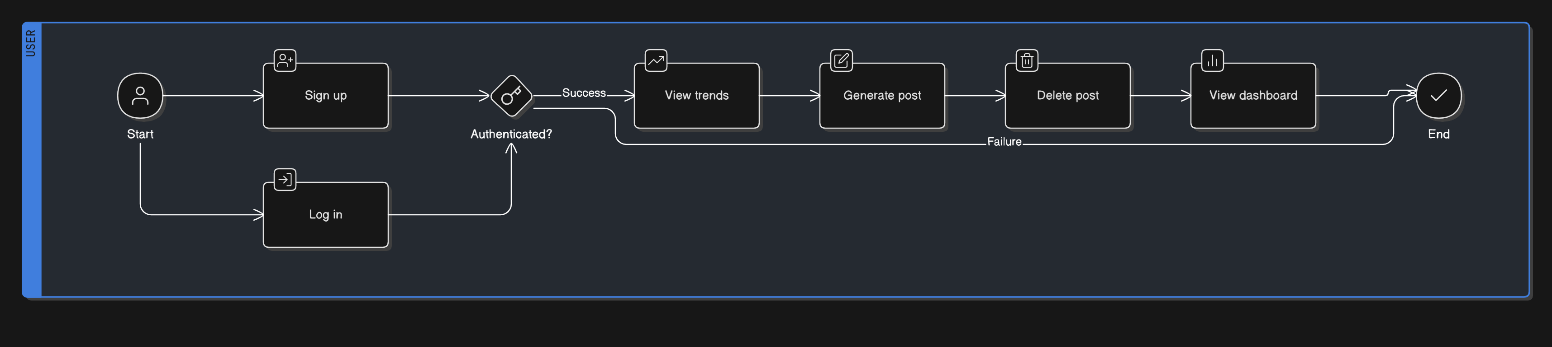
Use Case Diagram

Slide 11
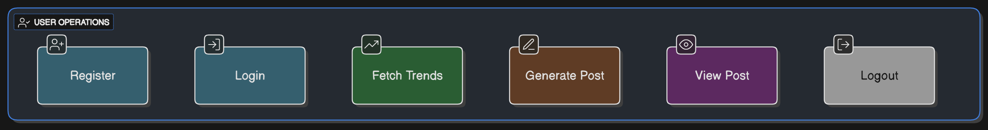
Activity Diagram

Slide 12
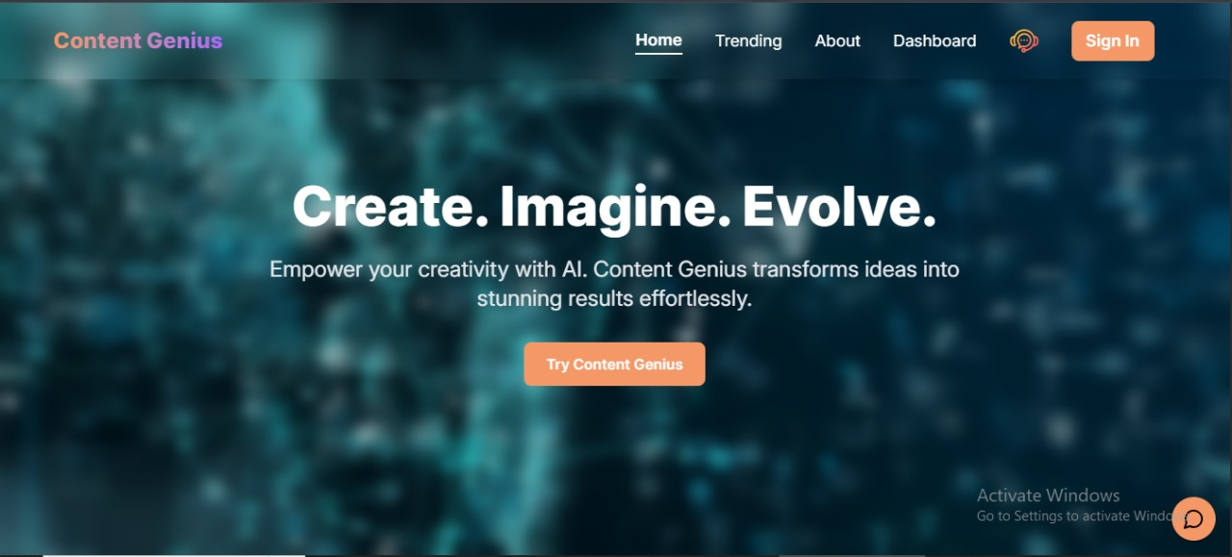
Interface

Slide 13
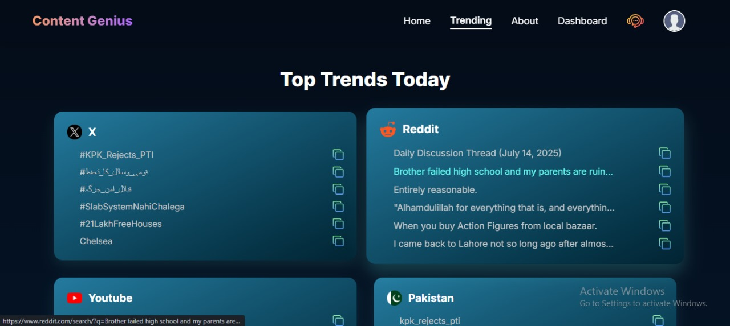
Interface

Slide 14
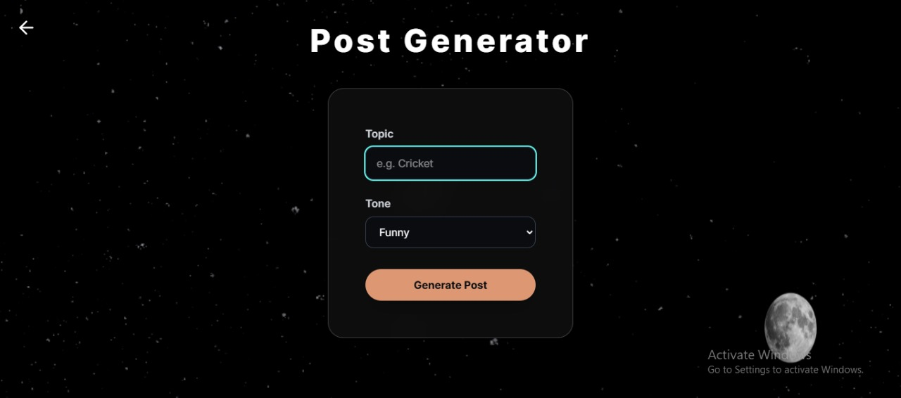
Interface

Slide 15
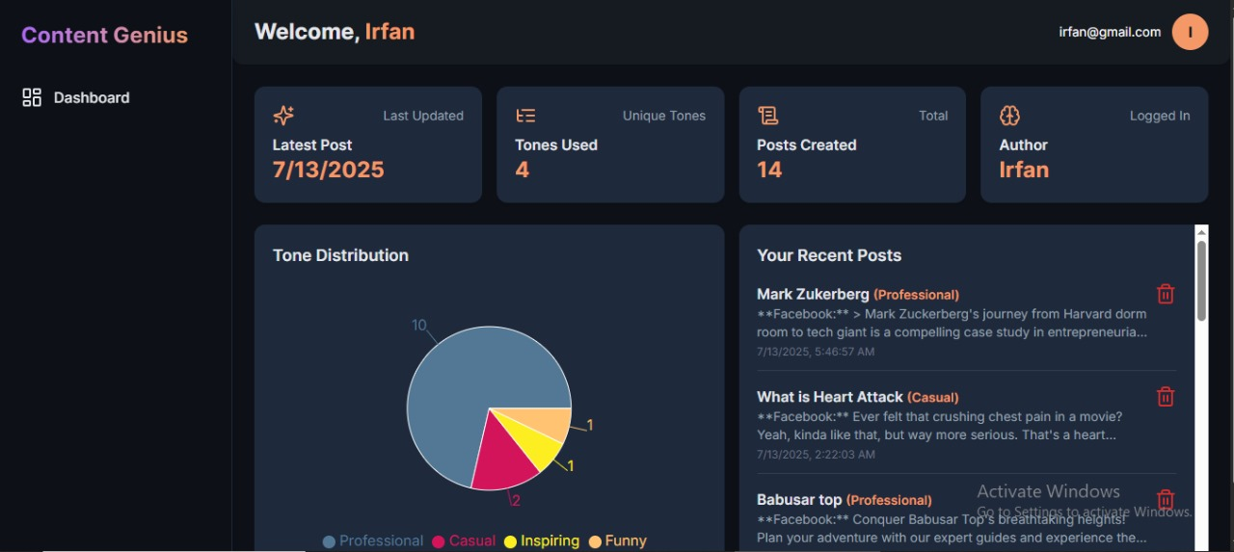
Interface

Slide 16
Implementation
Frontend: React + Vite + Tailwind + Lucide Icons +Redux Toolkit
Backend: Node + Express APIs with JWT
AI Integration: Gemini and Groq
MongoDB for storing posts/trends

Slide 17
Testing
ID | Scenario | Result
TC1 | Login valid user | Pass
TC4 | Fetch YouTube trends | Pass
TC7 | Generate post | Pass

